Slide 1

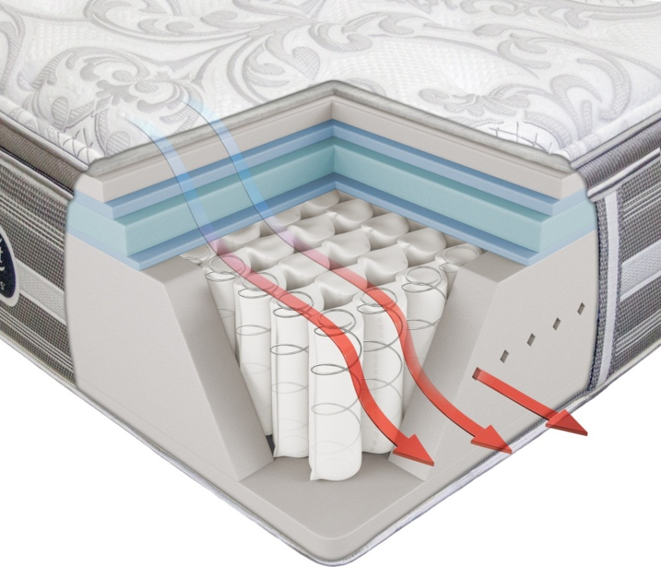
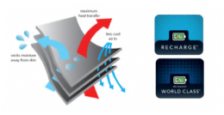
Vernazza™ Extra Firm
Built in the USA
World Class
Coil Unit..........1000 Density Beautyrest® Pocketed Coil® Springs
………..14 Ga.
Edge Support.........Ventilated AirCool® BeautyEdge®
.………Foam Encasement with QuantumLock™
Quilt......................SurfaceCool + Fiber™
......................3/4” GelTouch® Foam
.......……..….….1” Luxury Firm Comfort Foam
Upholstery..........1/2” Energy Foam®
…………AirCool® Memory Foam Center Third Support
AirCool® Design........AirCool® Breathable Border
….......AirCool® Foam
..........AirCool® BeautyEdge® Foam Encasement
Coil Support..................1 ½” Energy Foam®
Foundation....................Triton® Foundation w/ Steel Struts
...................Renew™ Adjustable Base Compatible
RECHARGING SLEEP
Beautyrest® Pocketed Coil® Technology provides conforming back support
10 Year Limited Warranty
Upgraded Technology
The “vertically” oriented SurfaceCool+ Fiber™ helps maximize airflow
AirCool® and Gel Foams provide pressure relief, promote freedom of movement and provide a comfortable sleeping temperature
Twin Set
Full Set
Queen Set
King Set
$0000
$0000
$0000
$0000

Slide 2

Built in the USA
Vernazza™ Plush
World Class
Coil Unit..........1000 Density Beautyrest® Pocketed Coil® Springs
………..15 ½ Ga.
Edge Support.........Ventilated AirCool® BeautyEdge®
.………Foam Encasement with QuantumLock™
Quilt.......................SurfaceCool + Fiber™
.......................1 ¼” AirFeel® Foam
......…..…..….….3/4” GelTouch® Foam
Upholstery...........1 ½” AirCool® Gel Memory Foam
AirCool® Design.........AirCool® Breathable Border
…......AirCool® Foam
.........AirCool® BeautyEdge® Foam Encasement
Coil Support..................1 ½” Energy Foam®
Foundation....................Triton® Foundation w/ Steel Struts
....................Renew™ Adjustable Base Compatible
RECHARGING SLEEP
Beautyrest® Pocketed Coil® Technology provides conforming back support
10 Year Limited Warranty
Upgraded Technology
The “vertically” oriented SurfaceCool+ Fiber™ helps maximize airflow
AirCool® and Gel Foams provide pressure relief, promote freedom of movement and provide a comfortable sleeping temperature
Twin Set
Full Set
Queen Set
King Set
$0000
$0000
$0000
$0000

Slide 3

Built in the USA
Vernazza™ Plush PillowTop
World Class
Coil Unit..........1000 Density Beautyrest® Pocketed Coil® Springs
………..15 ½ Ga.
Edge Support.........Ventilated AirCool® BeautyEdge®
.………Foam Encasement with QuantumLock™
Quilt.......................SurfaceCool + Fiber™
.......................1 ¼” AirFeel® Foam
......…..…..….….3/4” GelTouch® Foam
Deck………………….2” AirCool Gel Memory Foam
Upholstery............1/2” GelTouch® Foam
AirCool® Design.........AirCool® Breathable Border
…......AirCool® Foam
.........AirCool® BeautyEdge® Foam Encasement
Coil Support..................1 ½” Energy Foam®
Foundation....................Triton® Foundation w/ Steel Struts
....................Renew™ Adjustable Base Compatible
RECHARGING SLEEP
Beautyrest® Pocketed Coil® Technology provides conforming back support
10 Year Limited Warranty
Upgraded Technology
The “vertically” oriented SurfaceCool+ Fiber™ helps maximize airflow
AirCool® and Gel Foams provide pressure relief, promote freedom of movement and provide a comfortable sleeping temperature
Twin Set
Full Set
Queen Set
King Set
$0000
$0000
$0000
$0000

